Slide 1
Summary of data for Sigmodon hispidus at Hall’s Cave Site

Slide 2
Summary of Data
Lower age range | Upper age range | mean age | age range | Level | depths included | N (mass) | N (SIA) | Mean Mass (g) | StDev Mass | Mean delta 13C | StDev delta 13C | Mean 15N | StDev 15N | SEA
0 | 1458 | 729 | 1458 | 1 | 0-10 | 18 | 13 | 87.84 | 21.54 | -17.35 | 2.62 | 5.63 | 1.36 | 10.52
1458 | 2775 | 2116.5 | 1317 | 2 | 10-30 | 22 | 26 | 88.05 | 19.34 | -17.70 | 2.02 | 5.31 | 0.82 | 5.20
3104 | 4422 | 3763 | 1318 | 3 | 30-60 | 7 | 7 | 91.26 | 10.08 | -18.16 | 2.64 | 6.20 | 1.16 | 9.15
4751 | 5410 | 5080.5 | 659 | 4 | 60-70 | 14 | 13 | 82.58 | 19.87 | -17.02 | 2.34 | 6.48 | 1.01 | 5.90
5410 | 6069 | 5739.5 | 659 | 5 | 70-80 | 20 | 28 | 88.37 | 13.55 | -16.63 | 2.80 | 5.74 | 0.80 | 6.31
6069 | 6398 | 6233.5 | 329 | 6 | 80-85 | 21 | 29 | 86.75 | 15.67 | -16.60 | 2.61 | 5.87 | 0.91 | 5.76
6398 | 6728 | 6563 | 330 | 7 | 85-90 | 29 | 15 | 92.06 | 15.55 | -17.03 | 2.78 | 6.09 | 0.64 | 5.63
6728 | 7716 | 7222 | 988 | 8 | 90-105 | 21 | 25 | 83.70 | 15.95 | -17.60 | 2.80 | 6.12 | 0.93 | 7.52
7716 | 8045 | 7880.5 | 329 | 9 | 105-110 | 19 | 12 | 85.50 | 19.38 | -14.57 | 2.23 | 7.19 | 1.42 | 9.17
8045 | 8375 | 8210 | 330 | 10 | 110-115 | 16 | 14 | 89.74 | 15.94 | -15.91 | 2.46 | 7.27 | 1.31 | 9.84
8375 | 8704 | 8539.5 | 329 | 11 | 115-120 | 0 | 23 |  |  | -16.05 | 2.75 | 7.00 | 1.02 | 7.77
8704 | 9033 | 8868.5 | 329 | 12 | 120-125 | 16 | 11 | 89.41 | 20.94 | -16.15 | 3.60 | 6.95 | 1.63 | 10.81
9033 | 9363 | 9198 | 330 | 13 | 125-130 | 22 | 15 | 81.43 | 17.83 | -16.49 | 2.63 | 6.75 | 0.81 | 6.26
9363 | 9692 | 9528 | 329 | 14 | 130-135 | 22 | 13 | 87.66 | 14.47 | -17.45 | 2.26 | 6.85 | 1.51 | 8.58
9692 | 10021 | 9857 | 329 | 15 | 135-140 | 22 | 8 | 88.34 | 17.82 | -14.51 | 3.02 | 6.91 | 1.07 | 6.34
10021 | 10351 | 10186 | 330 | 16 | 140-145 | 45 | 11 | 87.62 | 16.80 | -15.09 | 2.91 | 6.95 | 0.81 | 6.98
10351 | 11668 | 11010 | 1317 | 17 | 145-165 | 27 | 21 | 87.56 | 19.43 | -17.78 | 3.65 | 6.76 | 1.22 | 10.17
11668 | 13050 | 12359 | 1382 | 18 | 165-180 | 7 | 7 | 84.03 | 20.45 | -13.96 | 2.41 | 7.24 | 0.83 | 6.26
13915 | 15095 | 14505 | 1180 | 19 | 190-230 | 14 | 15 | 87.83 | 18.36 | -16.35 | 2.58 | 6.63 | 1.04 | 6.70
11668 | 15095 | 13382 | 3427 |  | 165-220 | 15 | 16 | 76.90 | 14.76 | -16.67 | 3.83 | 7.08 | 1.29

Slide 3
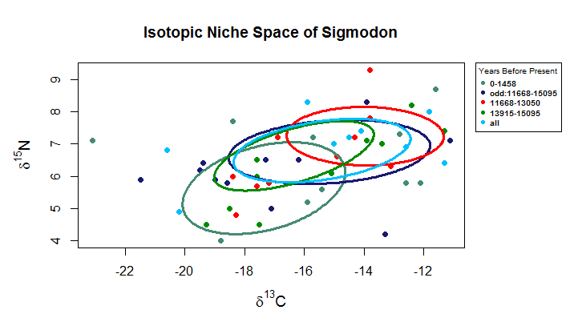
Notes:
This graph represents how the SEAs shift when including or excluding the bins that stretch between 160-220 and 170-220 to the last time bin included in the analysis.
The youngest time bin, 0-1458, is included for reference.
“Odd: 11668-15095” is the 160-220 and 170-220 plotted by themselves.
“All” indicates that the data from every bin that spans between 160 and 220 has been grouped.
The 11668-13050 and 13915-15095 are the older times bins according to the 19 bin division of the isotope data plotted with the 160-220 and 170-220 bins removed.
The 160-225 isotope data is much wider than either of the other two bins and placing them as a single set noticeably distorts the possible shift seen between these two periods. Because this bin is twice as large in time range than the next largest bin, I opted to remove it from the other graphs and thus the data we have for samples with this binning id are not included in the following slides.

Slide 4
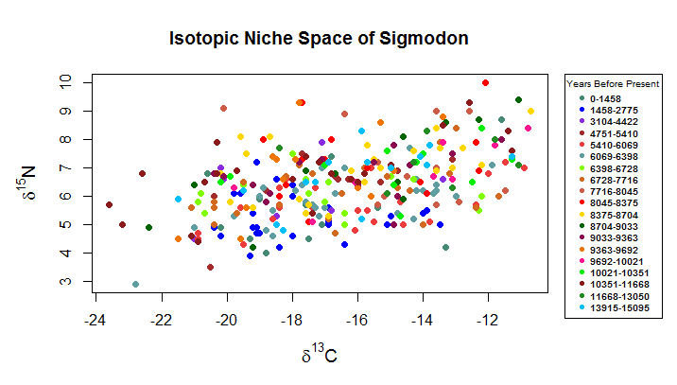

Slide 5
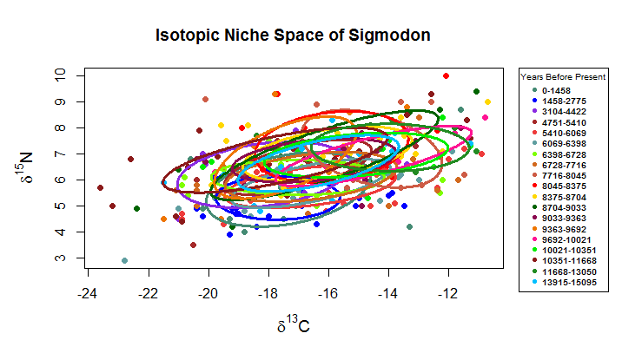

Slide 6
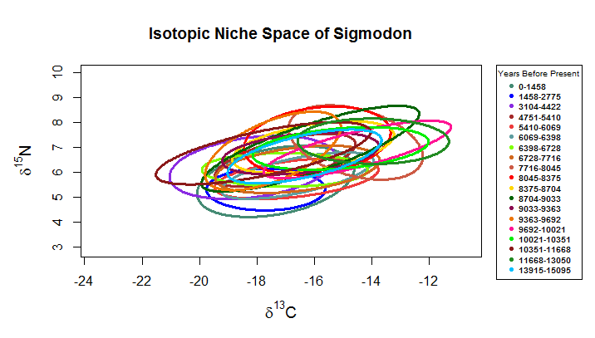

Slide 7
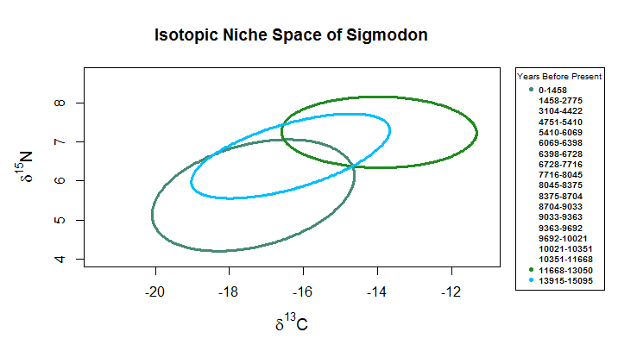
Notes:
Next slides are the SEAs in sequence from second oldest to second youngest, with oldest and youngest always being graphed for reference.
The youngest time bin has the second largest SEA.

Slide 8
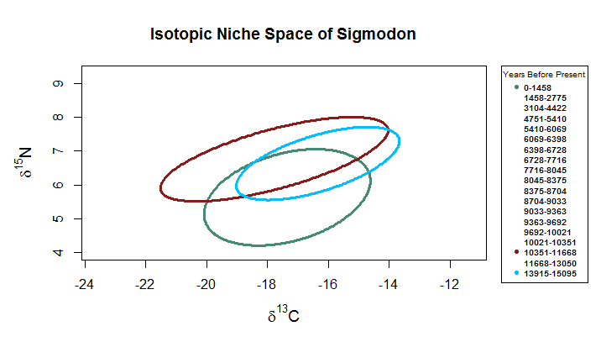

Slide 9
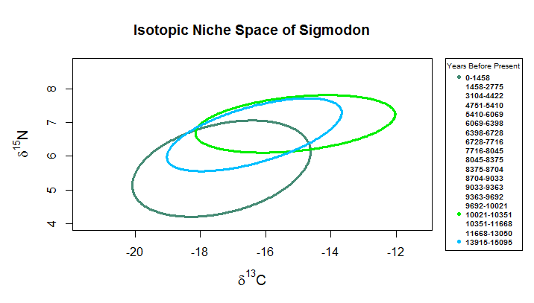

Slide 10
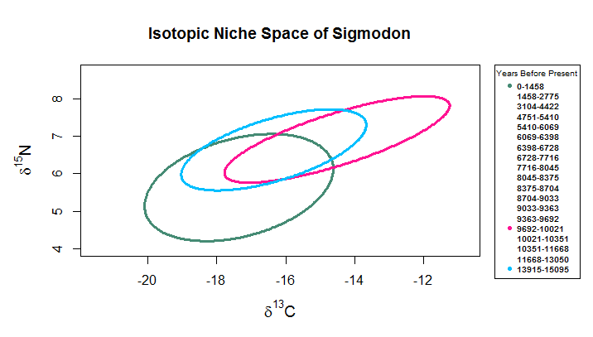

Slide 11
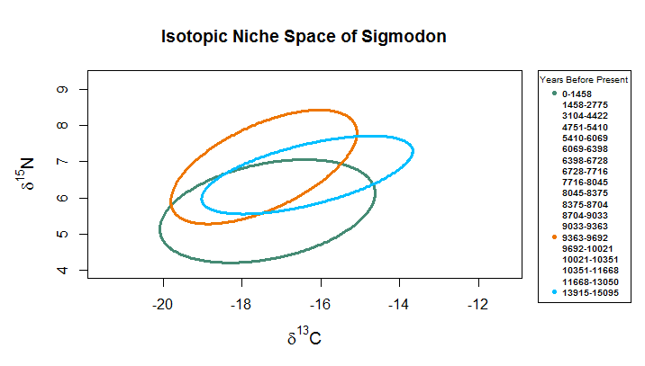

Slide 12
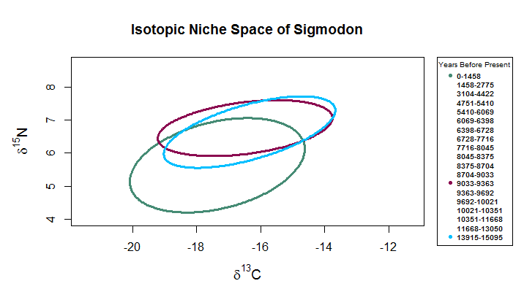

Slide 13
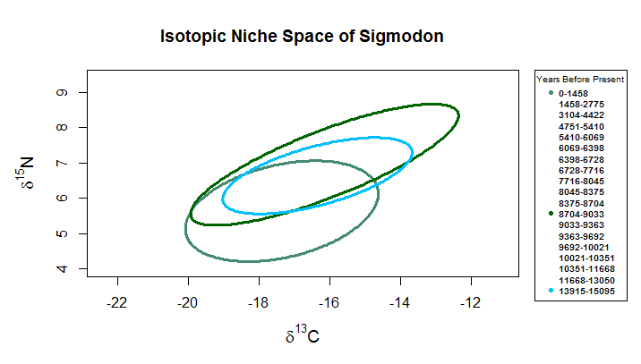
Notes:
8704-9033 is the largest SEA.

Slide 14
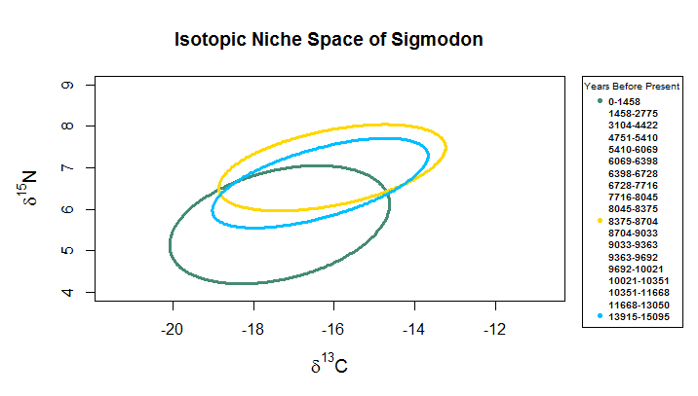

Slide 15
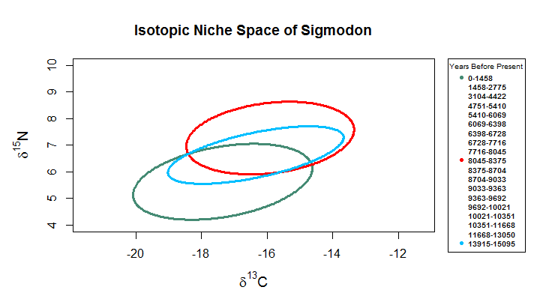

Slide 16
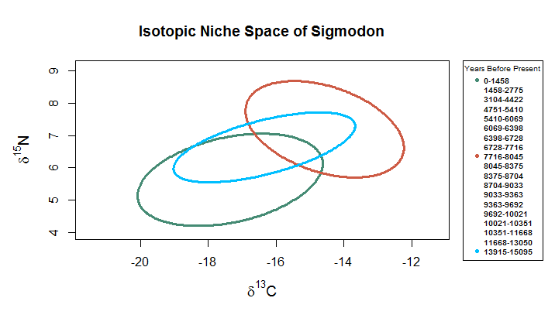

Slide 17
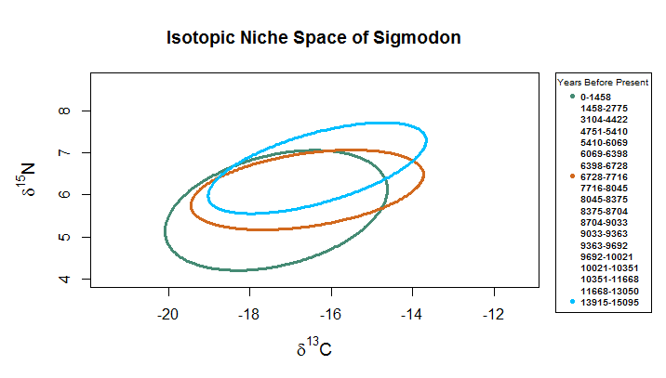

Slide 18
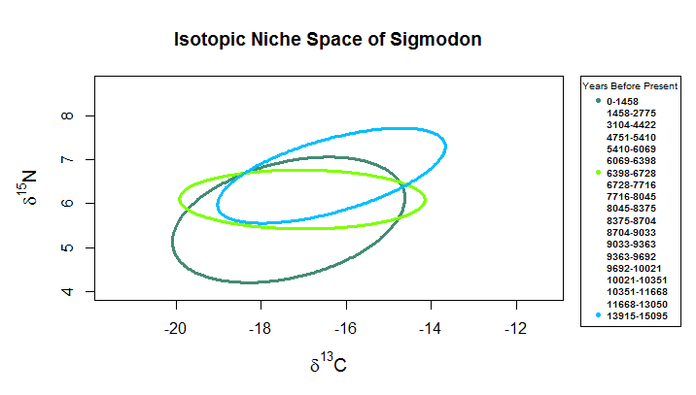

Slide 19
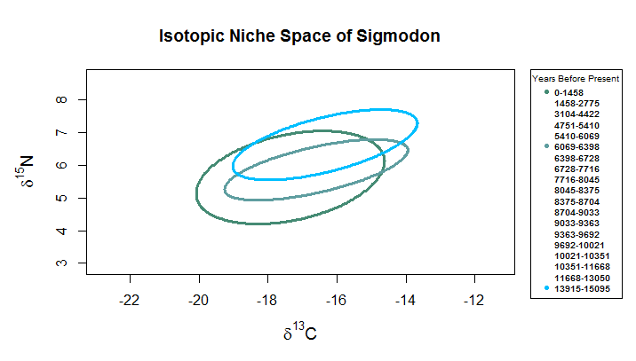

Slide 20
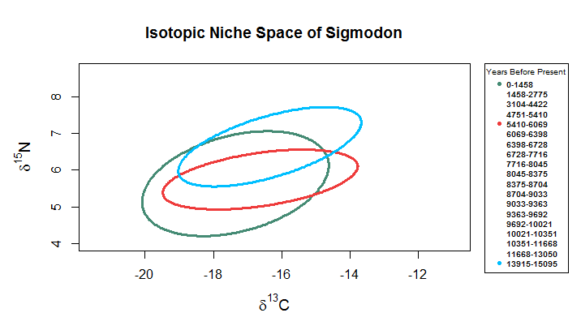

Slide 21
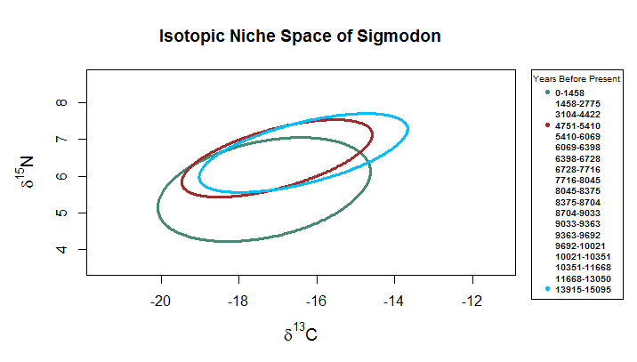

Slide 22
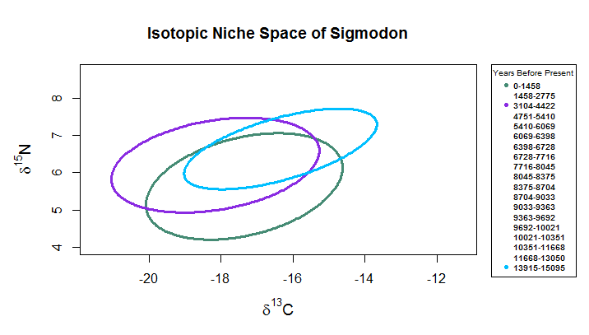

Slide 23
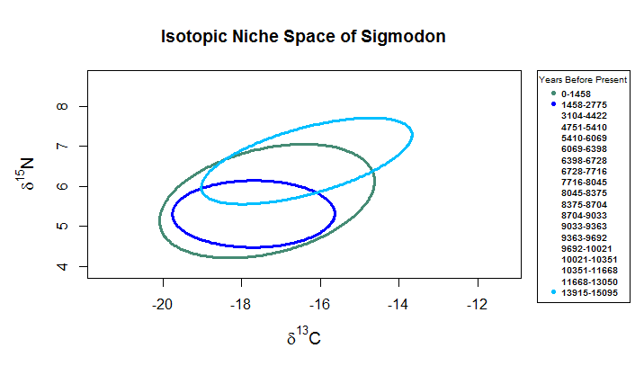
Notes:
The second youngest bin has the smallest SEA.

Slide 24
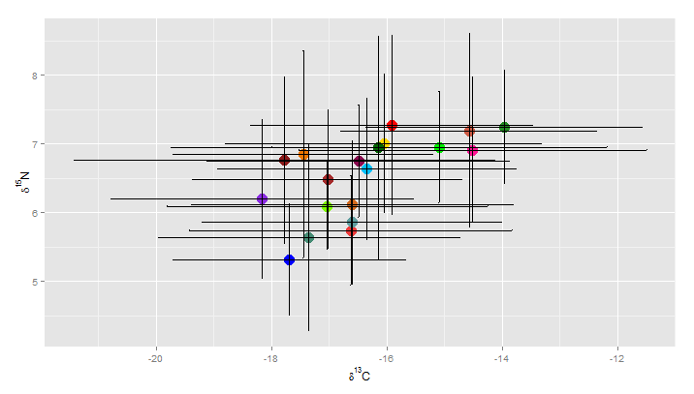

Slide 25
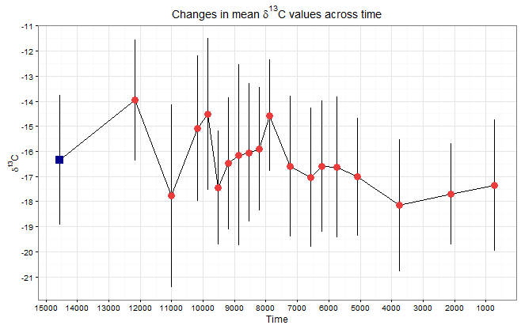
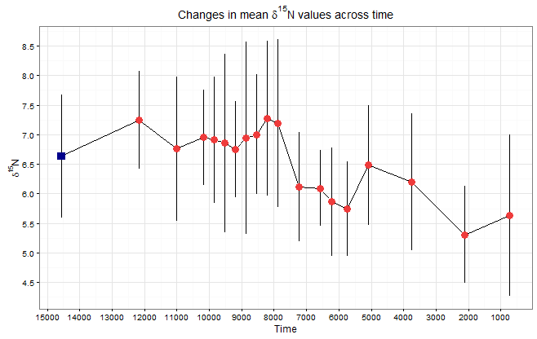

Slide 26
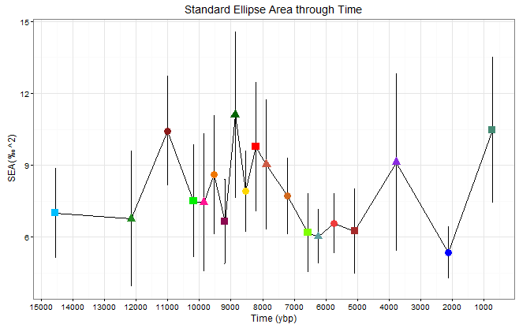
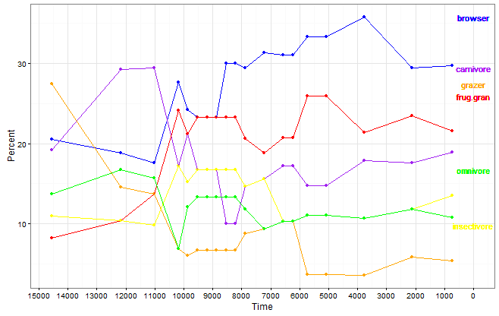
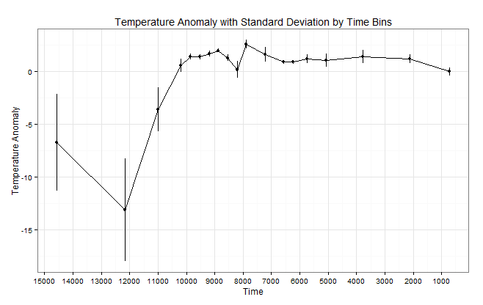

Slide 27
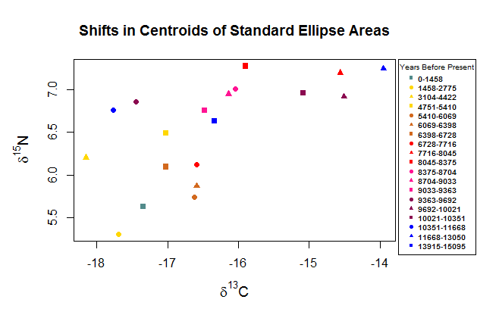

Slide 28
